Slide 1
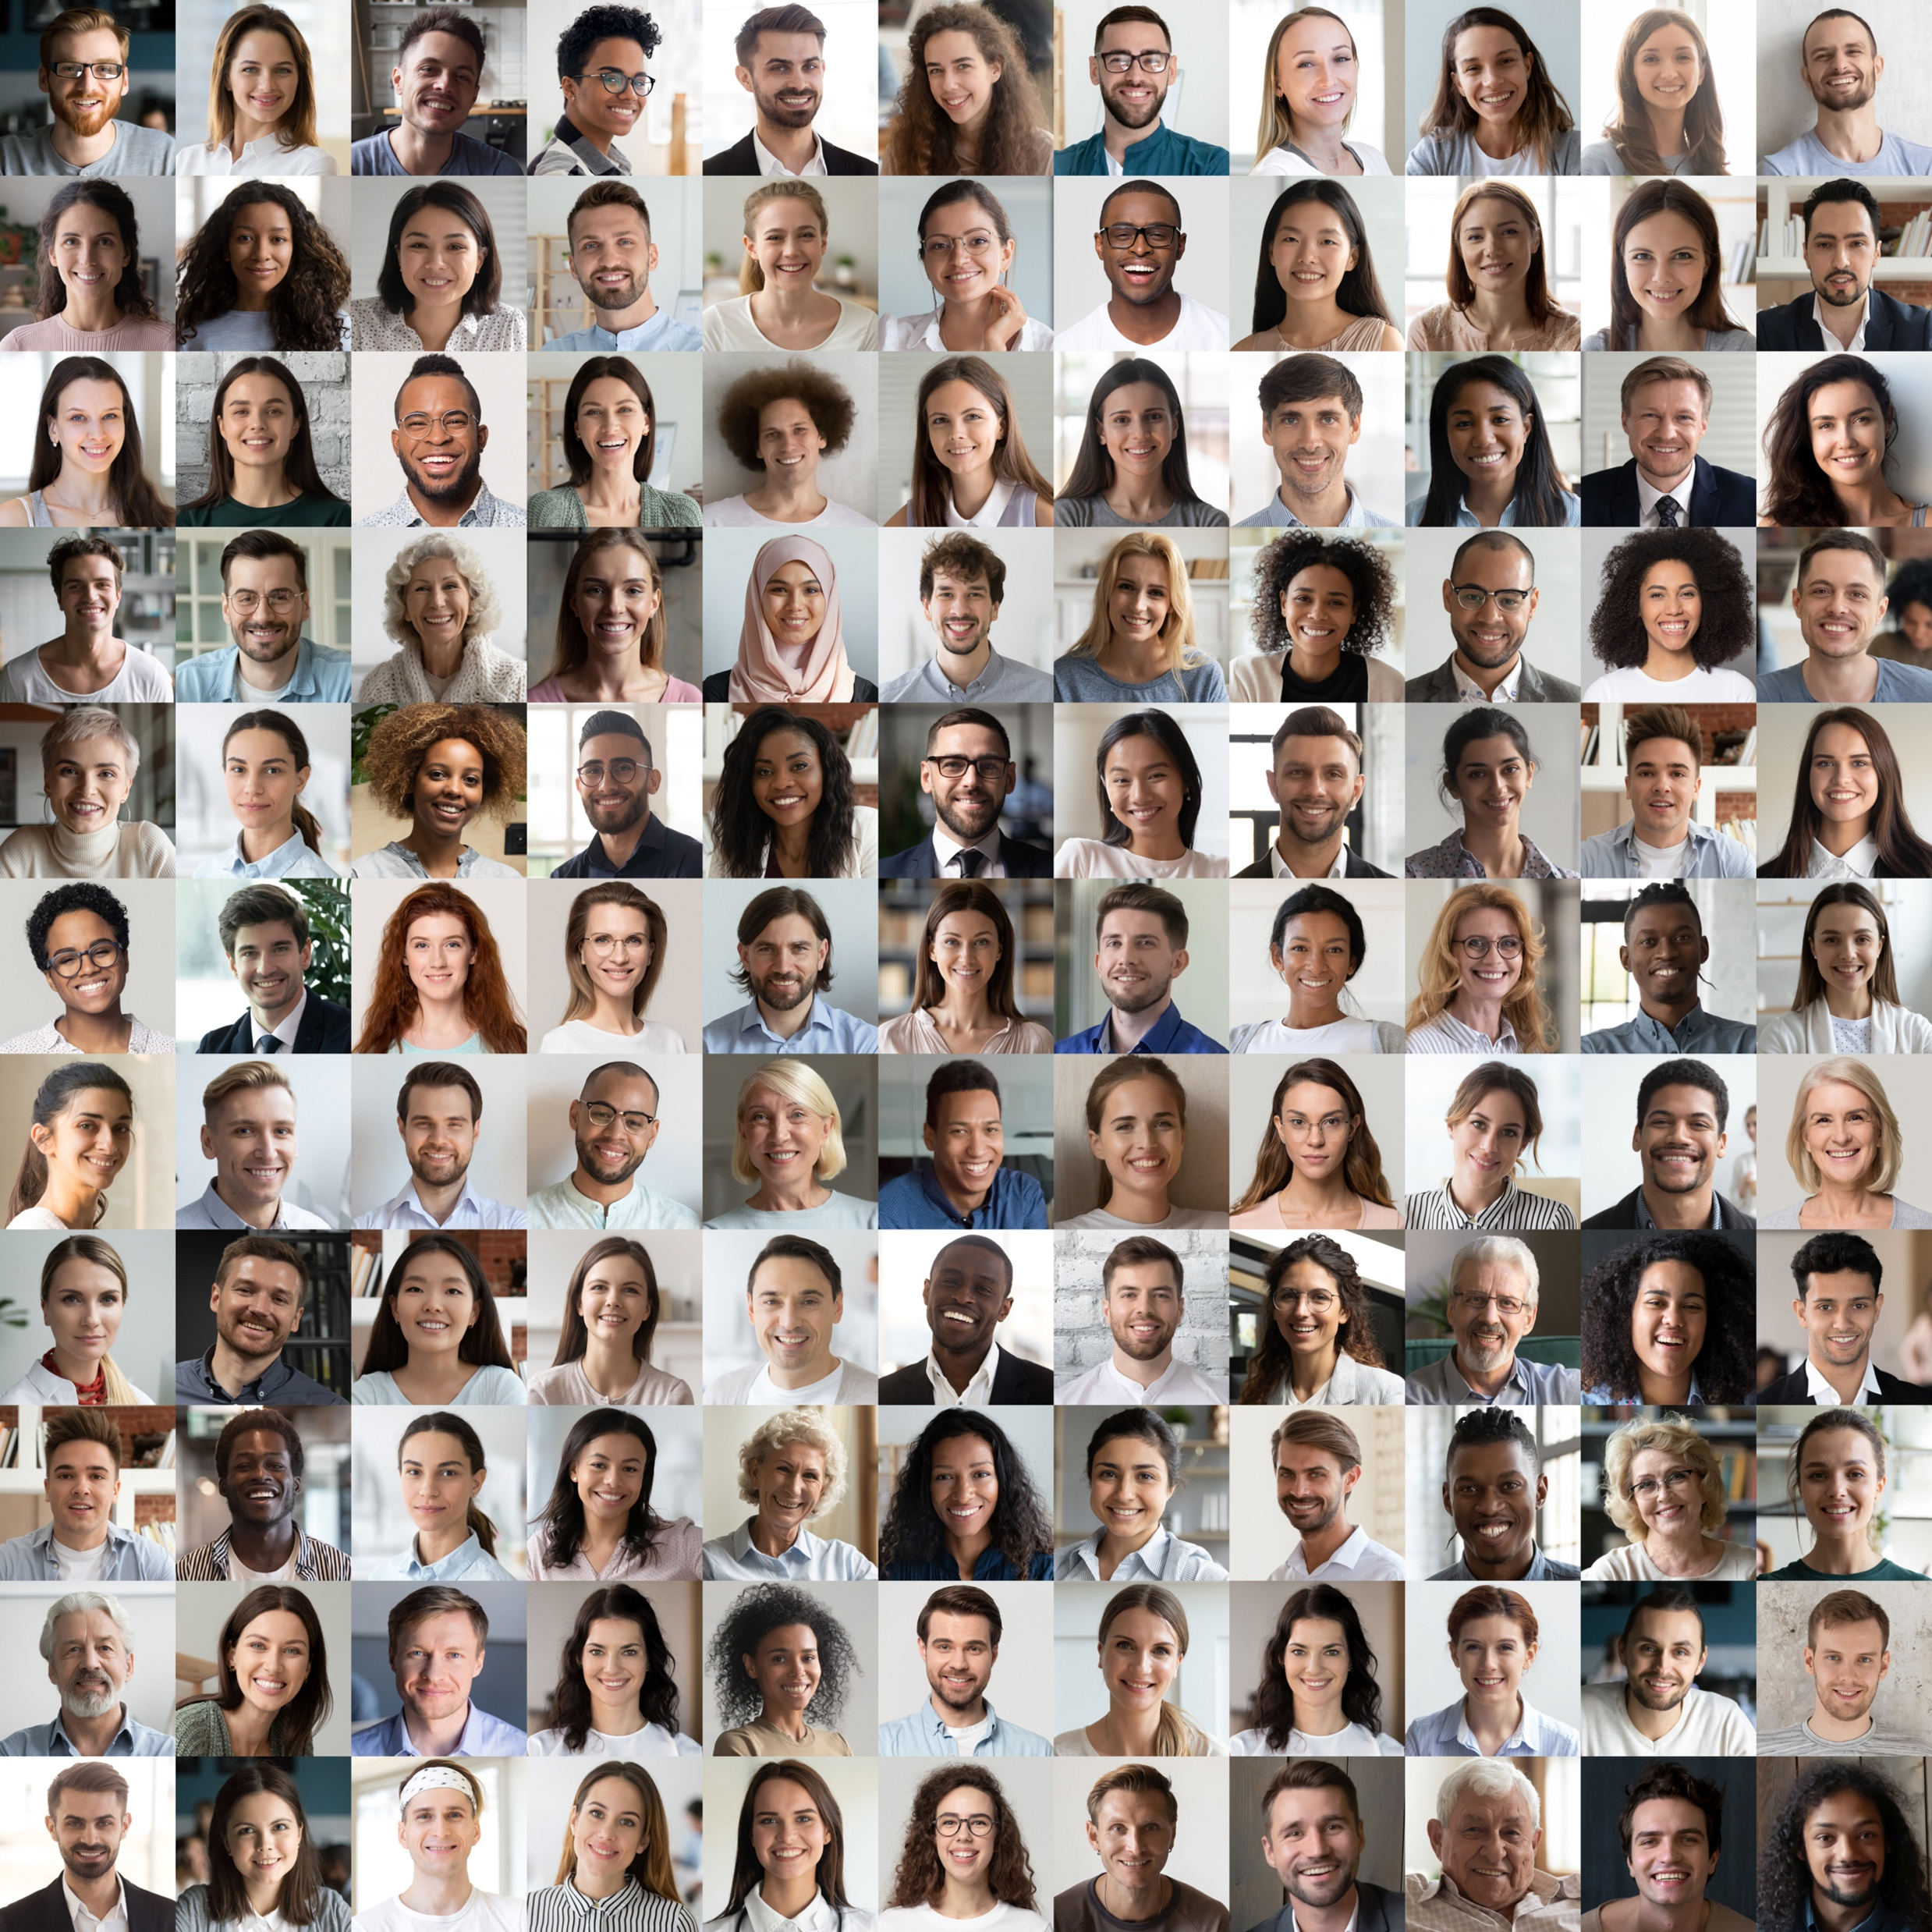

Assessing
Neurodiverse Candidates:
Expert Panel Discussion

Slide 2
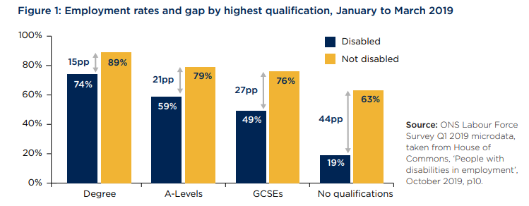
The Problem
Approximately 60% of people with autism, 55% with dyspraxia, and 53% with dyscalculia reported that people in their workplace behave in a way that excludes neurodivergent colleagues.
Just 1 in 10 organisations say consideration of neurodiversity is included in their people management practices, despite around 10% of the UK population being neurodivergent in some way.
People with learning disabilities have only 6% likelihood of achieving paid employment in their lifetime.
(Source: Fair Play Talks)
(Source: CIPD)
(Source: CIPD)
76% of graduates with a disability said they are concerned about being open about their disability during recruitment.
(Source: The Guardian)
77% of graduates with disabilities fear they will be discriminated against and 72% worry they will be a nuisance to employers.
(Source: The Guardian)
(Source: Office for Students)
Notes:
Fair Play Talks: https://www.fairplaytalks.com/2020/11/03/50-employers-admit-they-wont-hire-neurodivergent-talent-reveals-ilm-study/
CIPD: https://www.onrec.com/news/statistics-and-trends/neurodiversity-not-the-agenda-for-9-out-of-10-uk-organisations
The Guardian: https://www.theguardian.com/education/2015/mar/13/students-afraid-to-disclose-disabilities-to-potential-employers
Office for Students: https://www.officeforstudents.org.uk/publications/beyond-the-bare-minimum-are-universities-and-colleges-doing-enough-for-disabled-students/

Slide 3
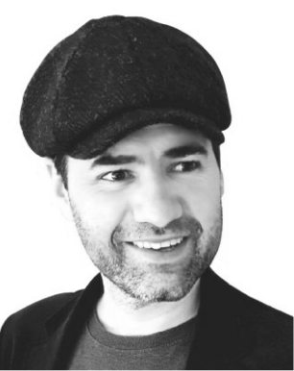
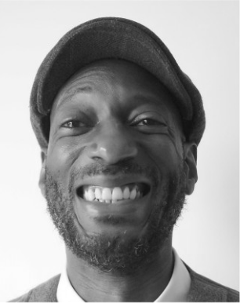
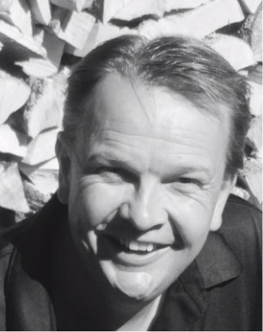
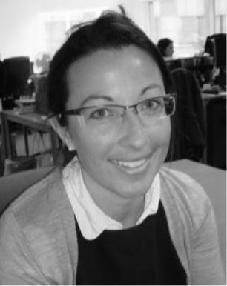
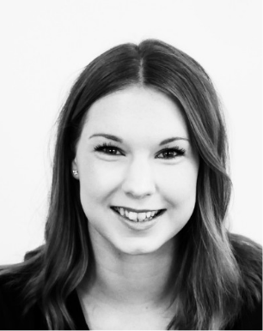
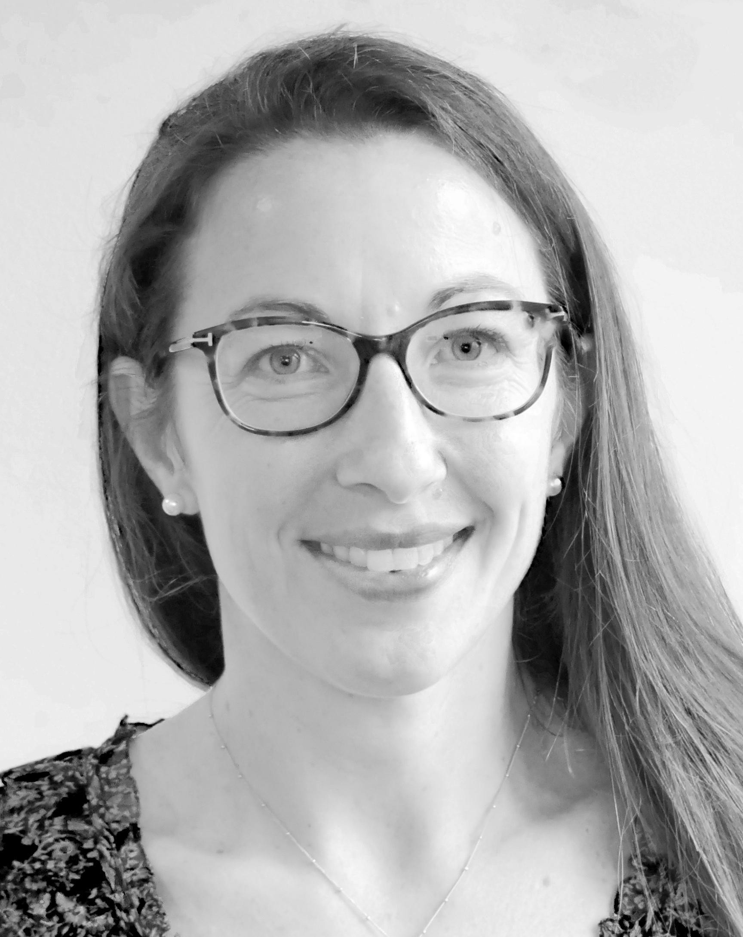
Our Panel
Theo Smith
Founder & Neurodiversity Evangelist, ND at Work
Chance
Bleu-Montgomery
Partner Support Manager, Prosper 4 Group & Bridge of Hope
James Fellowes
Founder, Bridge of Hope
Diane Crawford
Senior Assessment Consultant, Amberjack
Jenny Fitzgerald
Account Director, Amberjack

Slide 4
Next Steps
Access the ResourceHub
Expert Panelists:
Theo Smith, Neurodiversity at Work Founder
Theo@dynamisconsultancy.com, www.linkedin.com/in/theosmithuk/
James Fellowes, Bridge of Hope Founder
james.fellowes@bridgeofhope.careers, www.linkedin.com/in/jamesfellowes/
Chance Blue-Montgomery, Partner Support Manager at Prosper 4 Group, and Bridge of Hope
chance.bleumontgomery@prosper4.com, www.linkedin.com/in/chance-bleu-montgomery-6153691bb/
Amberjack: www.weareamberjack.com/, hello@weareamberjack.com, contact form
Notes:
71% said they would like to see examples of current disabled employees within organisations, while 70% said they would be more likely to be open about their disability if there was a dedicated member of staff that they could talk to during the recruitment process. Students afraid to disclose disabilities to potential employers | Students | The Guardian

